Slide 1
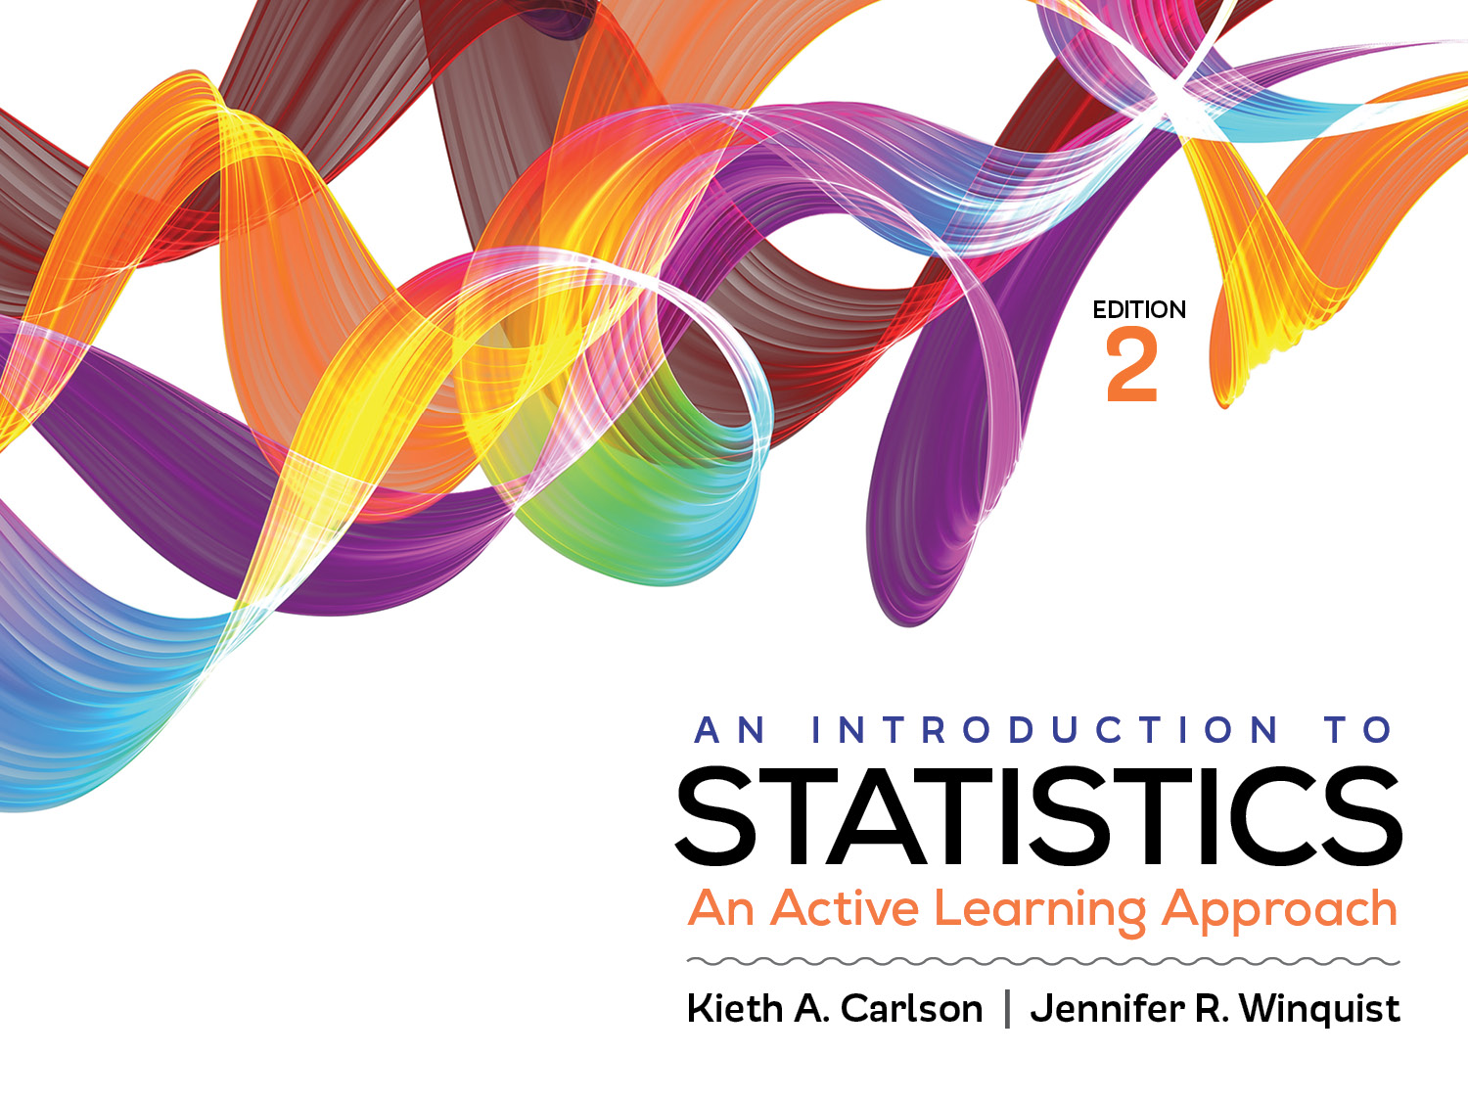
Introduction to Activity 11.1
Computing one-way ANOVA

Slide 2
Activity 11.1 will require you to:
Work through all 6 steps of an ANOVA hypothesis test
Identify researcher choices that would likely decrease within group and increase between group variance
Describe the logic of an independent ANOVA
Describe when and why post hoc tests are necessary

Slide 3
Analysis of Variance (ANOVA)
A hypothesis testing procedure for evaluating mean differences between two or more treatments (or populations)
Can compare more than two treatments (more than two levels of the IV)
There is an independent and repeated measures ANOVA, but we will only learn independent measures ANOVAs in this class

Slide 4
Analysis of Variance (ANOVA)
For now, our focus is on ANOVA for independent measure research designs with only one IV
Called single-factor, independent-measures designs
Also called one-way ANOVA because there is only one IV

Slide 5
The logic of ANOVA
Goal is to measure variability and determine where it comes from
Between treatments variability
OR
Within treatments variability

Slide 6
Sources of variability
Between Treatments variability can be created by
Treatment effect
Individual differences
Error
Within Treatments variability can be created by
Individual differences
Error
Identify examples of each

Slide 7
F: The test statistic for ANOVA
Use the obtained F value to compare the relative amount of variability created by treatments vs. individual differences and error.
If treatment has no effect, between and within group variability will be equal; F value will be 1; (null).
If treatment has an effect, between group variability will be more than within group variability; F value will be greater than 1; (research).
Why is this case?

Slide 8
F: The test statistic for ANOVA

Slide 9
F: The test statistic for ANOVA
If treatment has an effect, F > 1.
If treatment has no effect, F = 1.

Slide 10
Example problem
Does watching violent TV shows cause children to be more aggressive. To test this, a psychologist exposes 15-year-old boys to either no violence or low violence or high violence videos. Afterwards, the number of aggressive acts they engage in is recorded.

Slide 11
Step 1: Assumptions
Data independence
Appropriate measurement of IV (group) and DV (interval/ratio)
Normal distribution of sample means (for each group/condition)
Normal population or sample size greater than 30
Homogeneity of variance
The variability in each condition is similar (no condition is twice as variable as any other).

Slide 12
Step 2: Hypotheses

Slide 13
Step 2: Hypotheses
Null (H₀): µ = µ = µ . . .
All means will be equal;
F = 1; any deviation from 1 will be sampling error
Research (H₁):
At least one (possibly more) mean will be different from another
F > 1; deviation from 1 will be created by treatment differences

Slide 14
ANOVA notation
M = Mean
SS = Sum of squared deviations
g = Number of groups
n = Number of scores in each group
N = Total number of scores in the study (n*g)

Slide 15
Step 3: Define critical region
df _{between} = g – 1 = 3 – 1
df_{within} N – g = 15 – 3 = 12
Appendix C
df _{between} indicates column
df_{within} indicates row
F_{critical} = 4.75; therefore, if F_{obtained} > 4.75, reject null

Slide 16
Step 4: Compute F value
Treatment Conditions
1 (No Violence) |  |  | 2 (Low Violence) |  | 3 (High Violence)
3 | 7 |  |  | 12
3 | 10 |  |  | 10
4 | 8 |  |  | 14
2 | 8 |  |  | 11
3 | 7 |  |  | 13
M₁= 3 | M₂=8 |  |  | M₃= 12
SS₁= 2 |  | SS₂=6 |  | SS₃= 10
SD₁= .71 |  | SD₂= 1.22 |  | SD₃= 1.58

Slide 17
The scores are different within each treatment condition (More differences = greater within treatment variability)
Treatment Conditions
1 (No Violence) 2 (Low Violence) 3(High Violence)
3 7 12
3 10 10
4 8 14
2 8 11
3 7 13
M₁= 3 M₂= 8 M₃= 12
The means between the treatment conditions are different (More differences = greater between treatment variability)

Slide 18


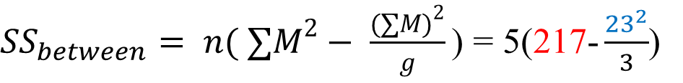
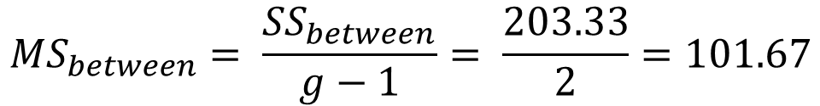
Between Treatment Variability
1 (No Violence) |  | 2 (Low Violence) |  | 3(High Violence)
3 | 7 |  | 12
3 | 10 |  | 10
4 | 8 |  | 14
2 | 8 |  | 11
3 | 7 |  | 13
M₁ = 3 | M₂= 8 |  | M₃ = 12
SS₁ = 2 | SS₂= 6 |  | SS₃ = 10

Slide 19
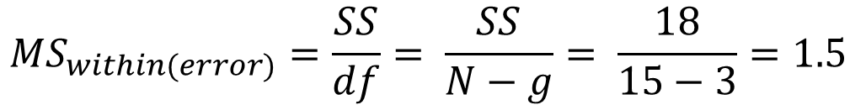
Within Treatment Variability
1 (No Violence) |  | 2 (Low Violence) |  | 3 (High Violence)
3 | 7 |  | 12
3 | 10 |  | 10
4 | 8 |  | 14
2 | 8 |  | 11
3 | 7 |  | 13
M₁= 3 | M₂=8 |  | M₃= 12
SS₁= 2 | SS₂=6 |  | SS₃= 10
g = number of groups

Slide 20
ANOVA Summary table
Source | SS | df | MS
Between | 203.33 | 2 | 101.67
Within | 18 | 12 | 1.5
Total | 221.33 | 14
Don’t need total MS. Between and within will not add up to total

Slide 21
F ratio

Slide 22
Rejecting the null and Post-Hocs
Critical value for this experiment
Reject null if F > 4.75
Reject the null
Violent TV did have an effect on aggression
Null hypothesis was that all three of the means are equal.
Because null was rejected, you must do post hocs to determine which means are different from each other.

Slide 23
Post-Hoc tests
Do post-hoc tests to figure out which of the means are significantly different
Any (or all) of these means could be different

Slide 24
Post-Hoc tests
Do all “pair-wise” comparisons to determine which means are significantly different from each other.
There are many different kinds of post-hoc tests. We will be using the HSD.

Slide 25
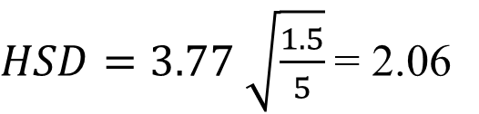
HSD post-hoc tests
q comes from a Table
Will need to know:
g, df from MS_{within}, α
n = # of scores in each treatment
Mean differences greater than HSD are significant

Slide 26
TV violence experiment means
Mean Differences
Group 1: No Violence; M = 3
Group 2: Low Violence; M = 8
Group 3: High Violence; M = 12
All groups are different from each other.
Group three had higher scores than group 2, which had higher scores than group 1.
5*
4*
9*

Slide 27
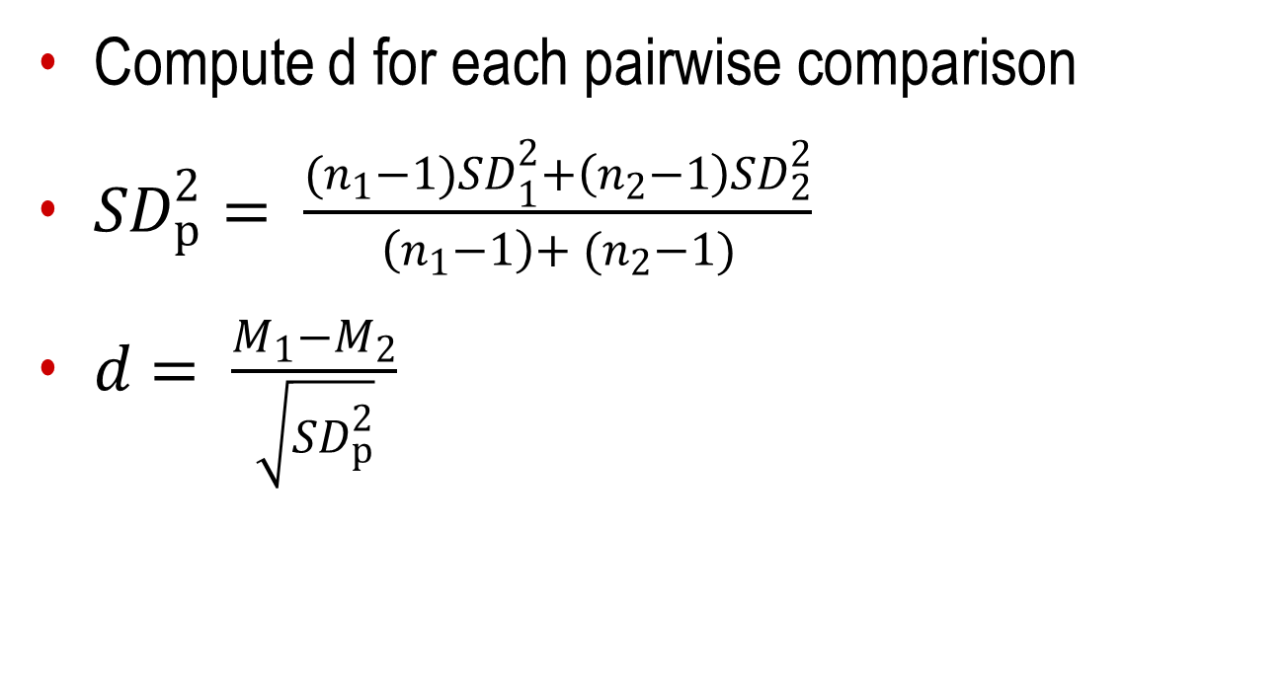
Step 5: Effect sizes for pair-wise comparisons

Slide 28
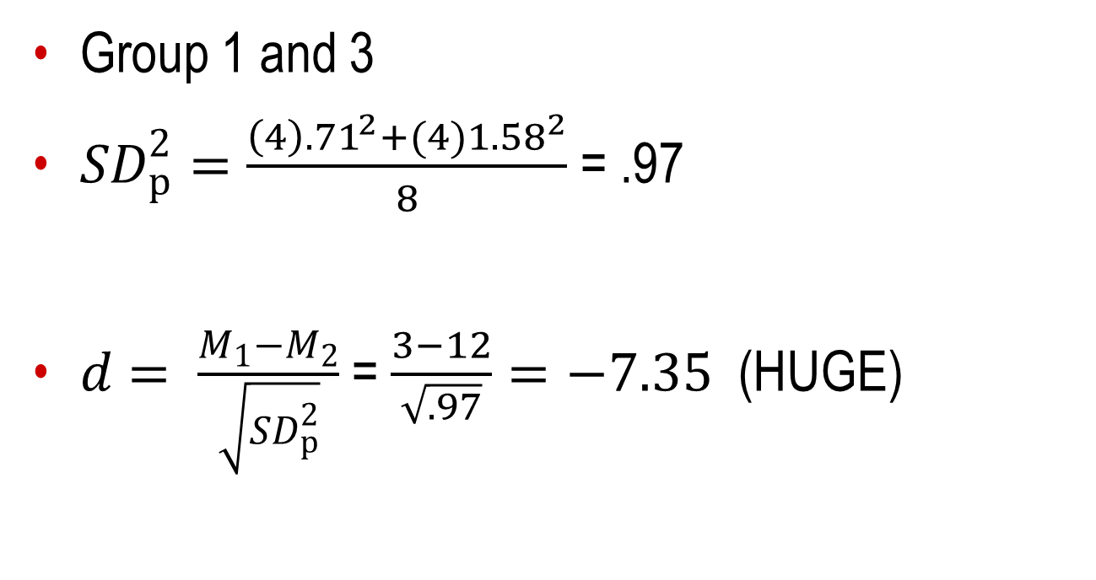
Effect sizes for pair-wise comparisons

Slide 29

Effect sizes for pair-wise comparisons

Slide 30
Step 6: Summarize the results
Watching violent videos did effect the number of aggressive acts 15-year-old boys commented, F (1,12) = 67.78, p < .05, η² = .92. All groups were significantly different from each other. The more violence the boys watched the more aggressive acts they committed later. Means, standard deviations and effect sizes are in Table 1.

